Slide 1
Strategie nauczania
Strategia nauczania może być zdefiniowana jako zbiór metod
i narzędzi, które są stosowane
w procesie edukacyjnym w celu podniesienia jego efektywności.
„Metody” oznaczają tutaj zasady
i sposoby organizacji wiedzy.
„Narzędzia” oznaczają media służące reprezentacji i przekazywaniu wiedzy.

Slide 2
Ważne pytania
Jak wybrać strategię nauczania odpowiednią dla danego stylu uczenia się?
Wybierając strategię nauczania należy wziąć pod uwagę: cel kształcenia, styl uczenia się ucznia, specyfikę przedmiotu nauczania, poziom wiedzy ucznia, poziom wiedzy nauczyciela, dostępne środki dydaktyczne i media, które można wykorzystać do przekazania wiedzy.

Slide 3
Przykład
FOSTERING ADAPTIVITY IN
E-LEARNING PLATFORMS:
A META-MODEL SUPPORTING ADAPTIVE COURSES
Sabine Graf
Vienna University of Technology

Slide 4
The meta-model is based on the Felder-Silverman learning style model
active learners learn by trying things out and working with others
reflective learners learn by thinking things through and working alone
sensing learners like to learn concrete material and tend to be practical
intuitive learners prefer to learn abstract material such as theories and their meanings and tend to be more innovative than sensing learners.

Slide 5
visual learners remember best what they have seen
verbal learners get more out of words, regardless whether they are spoken or written.
sequential learners learn in linear steps and prefer to follow linear stepwise paths
global learners learn in large leaps and are characterized as holistic

Slide 6
Style uczenia się – klasyfikacja Felder&Soloman
Poziom: działanie
- styl uczenia się: aktywny,
- styl uczenia się: refleksyjny,
Poziom: percepcja (postrzeganie)
- styl uczenia się: odbiorczy,
- styl uczenia się: intuicyjny,
Poziom: odbiór
- styl uczenia się: wizualny,
- styl uczenia się: werbalny,
Poziom: rozumienie
- styl uczenia się: sekwencyjny,
- styl uczenia się: globalny.

Slide 7
Each course includes an outline at the beginning, presenting all chapters, and a conclusion summarizing
the highlights of the course. Similarly, each chapter has an outline and conclusion. To provide global learners
with a better orientation, outlines can be presented additionally after each chapter or after each learning unit,
whereas for sequential learners outlines can also be completely hidden.

Slide 8
Content objects represent the content of the course in small pieces, including also outlines and conclusions. Content objects can include text as well as all kinds of images to support verbal learners as well as visual learners. Additionally, the objects can contain content links, for example to additional information about the current concept or to related topics. By providing these links, global learners have the possibility to relate the learned material to other topics and to get additional information. For sequential learners, the links can be hidden to make the course more linear. However, a collection of links can be presented, for example, at the end of a chapter.

Slide 9
Multimedia objects can be integrated into content objects. For example, audio objects can include short statements from an expert on a specific topic or question, and interactive animations can help learners to understand by trying out. Therefore, multimedia objects are a good supplement to textual content and can support visual, active, and sensing learners. However, multimedia objects can also be hidden to avoid cognitive load or to provide a more linear course schedule. Also a collection of multimedia objects is possible. In general, slides which are used for traditional education might be applied as content objects after a short revision.

Slide 10
The meta-model also contains examples, which are used for better illustration. Each example is related to
one or more specific content objects. Examples are especially important for sensing learners. Therefore,
courses which are adapted to the needs of sensing learners can consist of more examples than courses for intuitive learners.
The meta-model includes exercise objects. To provide learners with opportunities to practice, exercise objects consist of several questions about interpreting predefined solutions or developing new solutions. Because active learners tend to prefer to try something out by doing exercises, a course for these
learners can include more exercises than a course for reflective learners.

Slide 11
For testing the acquired knowledge, the meta-model contains test objects.
Because the learning progress of sequential learners is linear, they prefer to be tested in shorter intervals than global learners who need more time to get the big picture of a topic. For the latter, tests at the end of a chapter are more suitable.

Slide 12
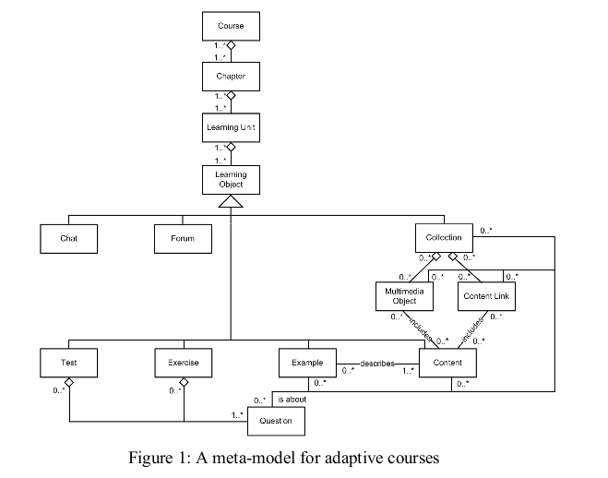

Slide 13
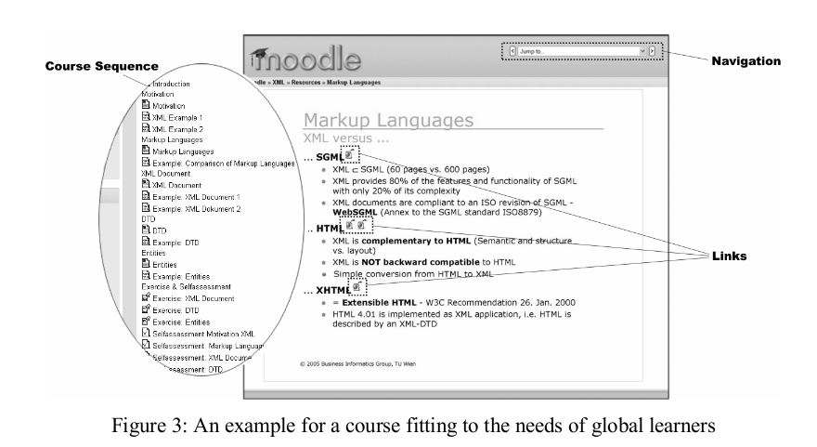

Slide 14
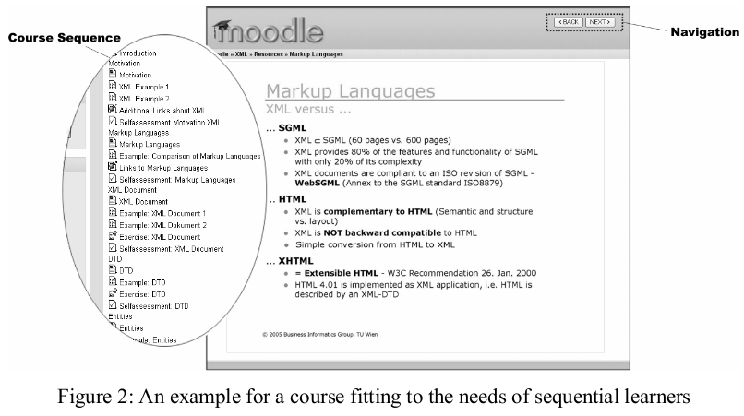

Slide 15
These two course instances include three possible differences. They are structured in a different way, the content objects may or may not include links, and the navigation is designed once by showing a drop-down listbox including all learning objects and once by highlighting the next and back button.
Our future work will also focus on dynamic aspects trying to detect the learners' learning style from their behavior during the course and using this information to assign a suitable course instance.

